Slide 1

8th Grade Math: Pre-Algebra
Unit 10, Lesson 10 Using Tables to Determine If a Function Is Linear Volume 2, pg. 168

Slide 2


Benchmark
MA.8.F.1.2
Given a function defined by a graph or an equation, determine whether the function is a linear function. Given an input-output table, determine whether it could represent a linear function.
volume 2, pg. 168

Slide 3
Integrated Mathematical Thinking and Reasoning Standards
MA.K12.MTR.1.1 Actively participate in effortful learning both individually and collectively.
MA.K12.MTR.2.1 Demonstrate understanding by representing problems in multiple ways.
MA.K12.MTR.5.1 Use patterns and structure to help understand and connect mathematical concepts.
volume 2, pg. 168

Slide 4

Learning Targets
I can determine whether a function could represent a linear function given a table of values.
I can determine whether a function is a linear function given an equation or graph.
volume 2, pg. 168

Slide 5

Warm-Up
volume 2, pg. 169

Slide 6
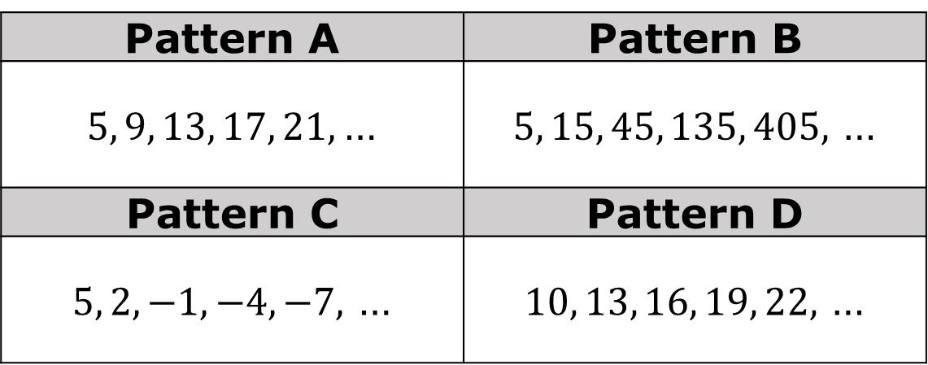
10.10.1 Warm-Up: Which One Doesn’t Belong?
Four number patterns are shown.
Pattern A | Pattern B
$5, 9, 13, 17, 21,$… | $5, 15, 45, 135, 405,$ …
Pattern C | Pattern D
$5, 2, −1, −4, −7,$ … | $10, 13, 16, 19, 22,$ …
volume 2, pg. 169

Slide 7
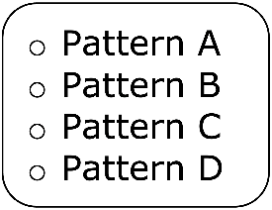
Complete the statement to explain which pattern doesn’t belong.
doesn't belong because ___________
__________________________________________.
volume 2, pg. 169

Slide 8
Find a classmate who selected a different pattern that doesn’t belong. Write their explanation in the table. You are the only person who should write in the first column of the table. Have the person initial next to your summary of their explanation stating that your summary is correct.
My summary of __________’s description | Initials
volume 2, pg. 169

Slide 9

Guided Practice
volume 2, pg. 169

Slide 10

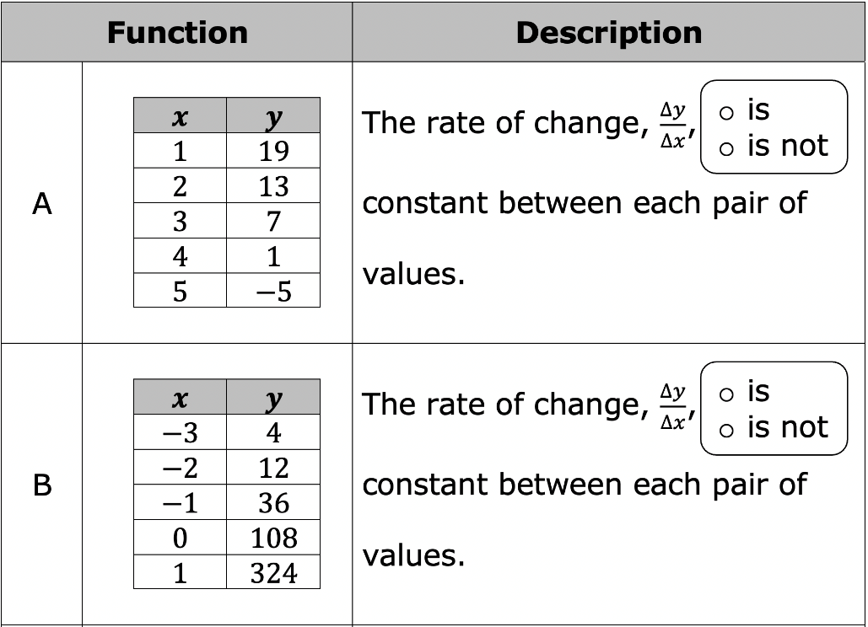
10.10.2 Guided Practice: Exploring Tables to Determine Linear Functions
Complete the description observed in the table of values for each function.
volume 2, pg. 169

Slide 11
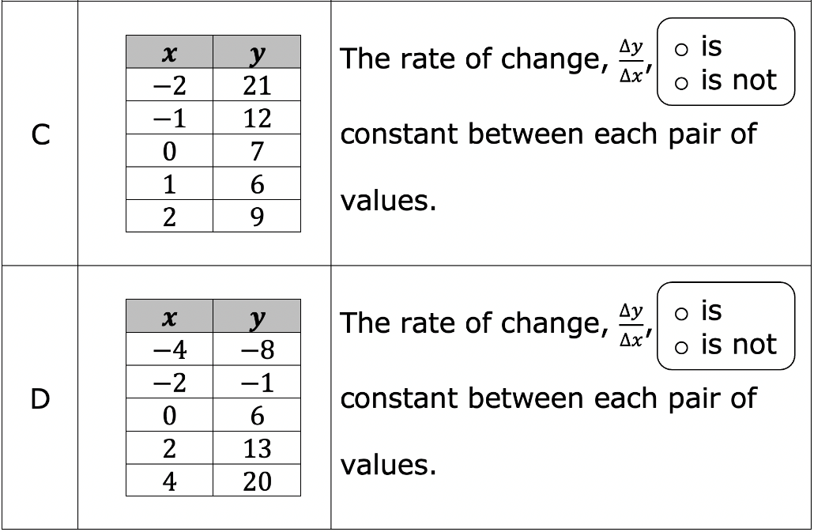
volume 2, pg. 169

Slide 12
For each table that has a constant rate of change, complete the statement.
In table _____ as the 𝑥-values increase by ____, the 𝑦-values _____________________________.
In table _____ as the 𝑥-values increase by ____, the 𝑦-values _____________________________.
volume 2, pg. 170

Slide 13
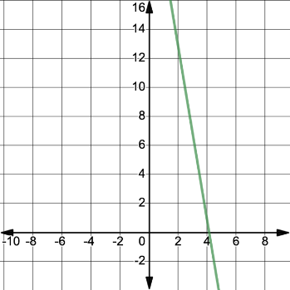
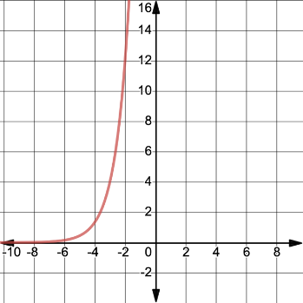
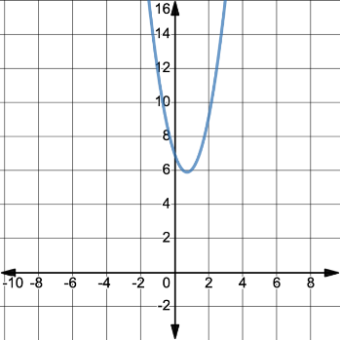
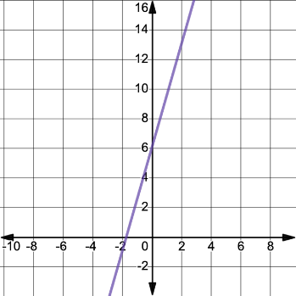
The graphs for each of the functions represented by tables are shown. Put an asterisk (*) next the graphs that are linear functions.
Graph A | Graph B
Graph C | Graph D
volume 2, pg. 170

Slide 14

Guided Instruction
volume 2, pg. 171

Slide 15

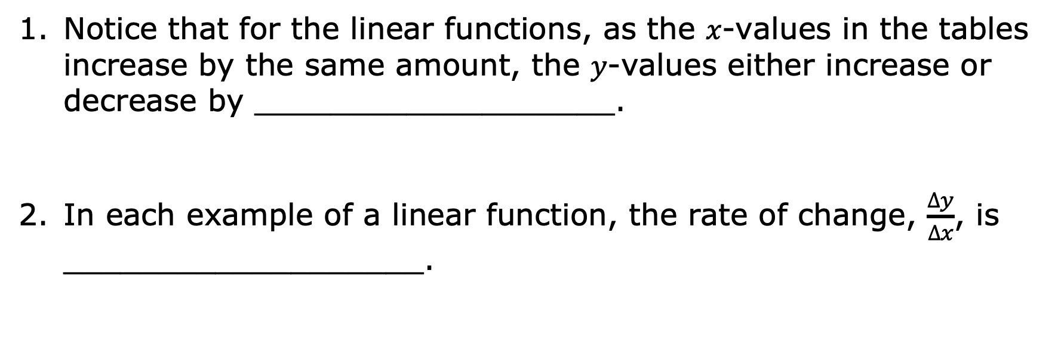
10.10.3 Guided Instruction: Identifying Linear Functions from Tables
Notice that for the linear functions, as the 𝑥-values in the tables increase by the same amount, the 𝑦-values either increase or decrease by ___________________.
In each example of a linear function, the rate of change, $\frac{∆y}{∆x}$, is ___________________.
A linear function is a function that has a constant rate of change.
volume 2, pg. 171

Slide 16
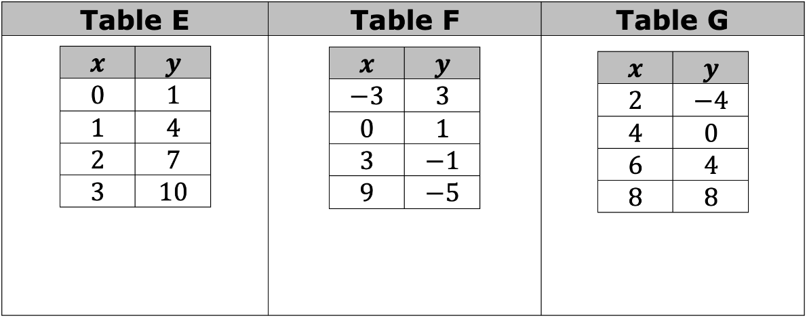
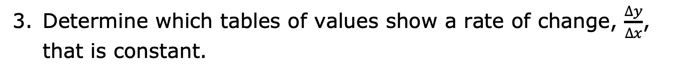
Determine which tables of values show a rate of change, $\frac{∆y}{∆x}$, that is constant.
volume 2, pg. 171

Slide 17
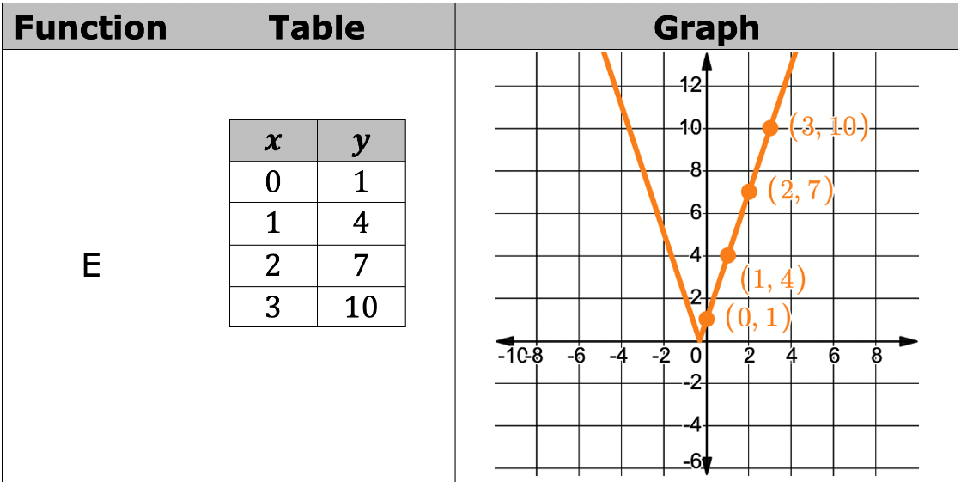
The graphs for each of the functions E, F, and G are shown with their corresponding table of values. If the function represents a linear function, circle the function’s letter.
volume 2, pg. 171

Slide 18
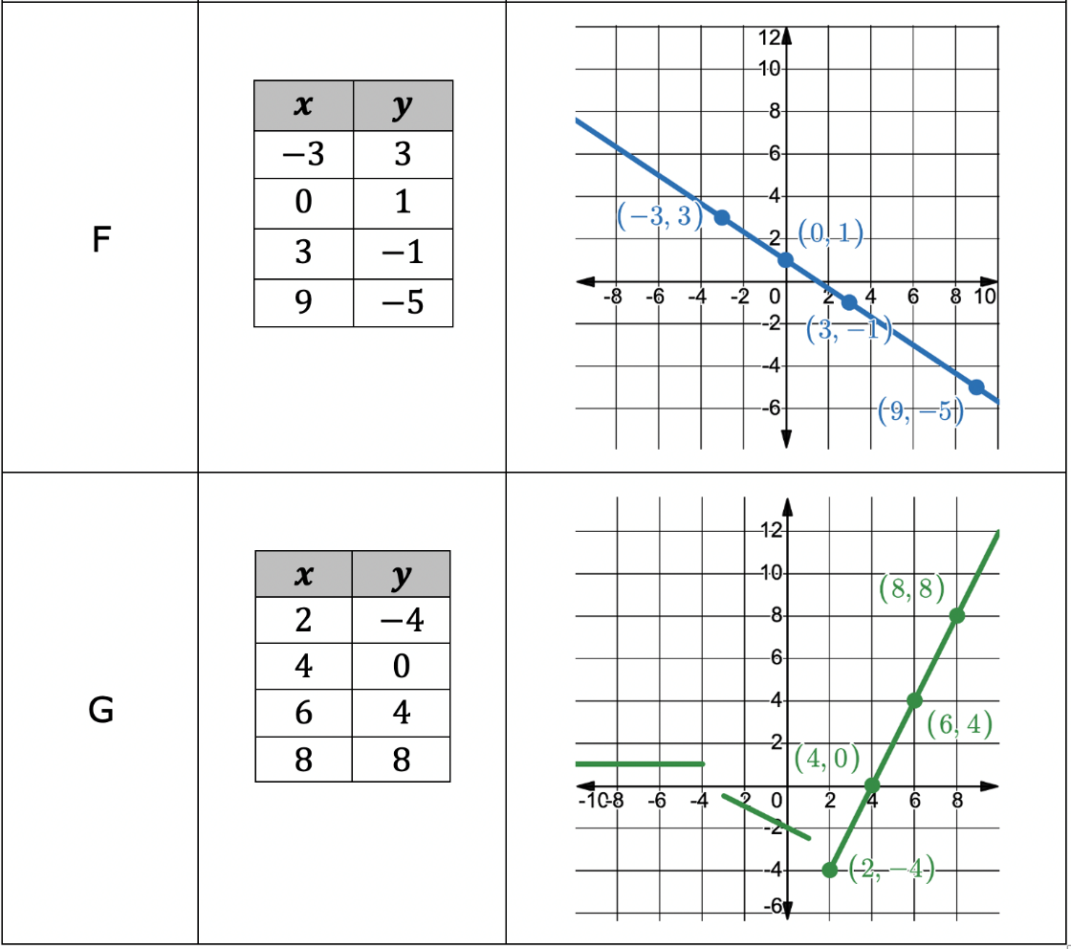
volume 2, pg. 171

Slide 19
In Function E, describe what is different in the graph that was not shown in the table.
In Function G, describe what is different in the graph that was not shown in the table.
volume 2, pg. 172

Slide 20
A table of values only gives some of the points on the graph of a function. This is not always enough information to conclude that a function is linear. Therefore, from a table of values, it can only be concluded that a function could represent a linear function.
volume 2, pg. 172

Slide 21

Your Turn
volume 2, pg. 172

Slide 22
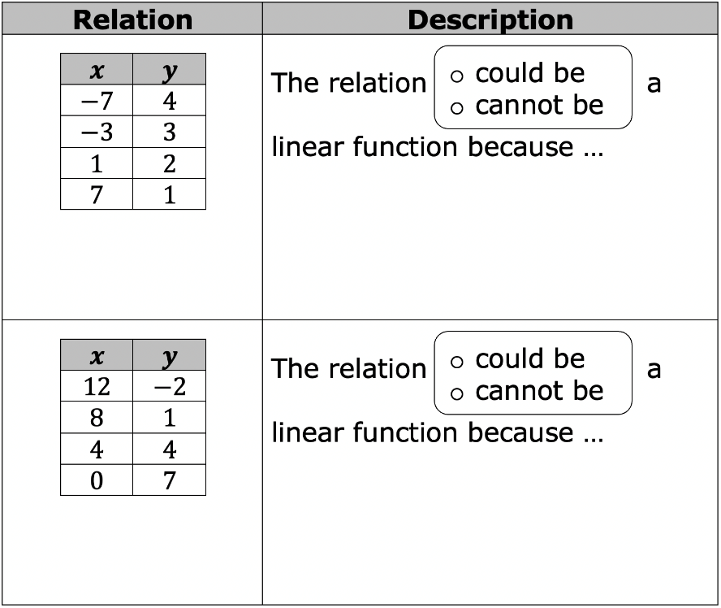
10.10.4 Your Turn!
Determine which relations could be linear functions. Show your work.
volume 2, pg. 172

Slide 23
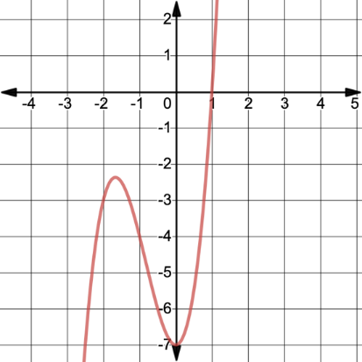
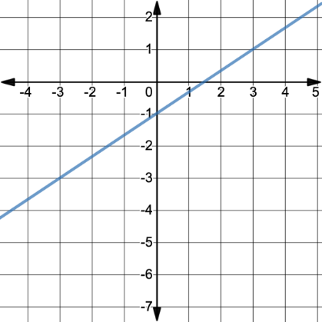
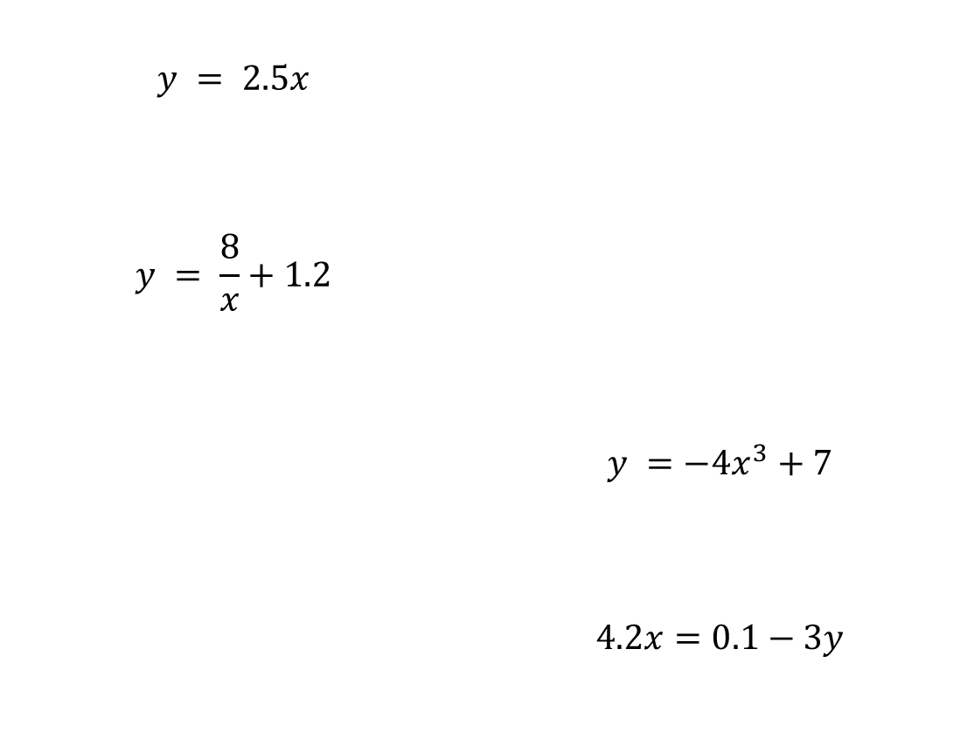
Six different relations are shown. Circle the relations that represent linear functions.
$$y = 2.5x$$ $$y = \frac{8}{x}+1.2$$
 | $$y =−4x^{3}+7$$ $$4.2x=0.1−3y$$
volume 2, pg. 173

Slide 24

Wrap-Up
volume 2, pg. 173

Slide 25
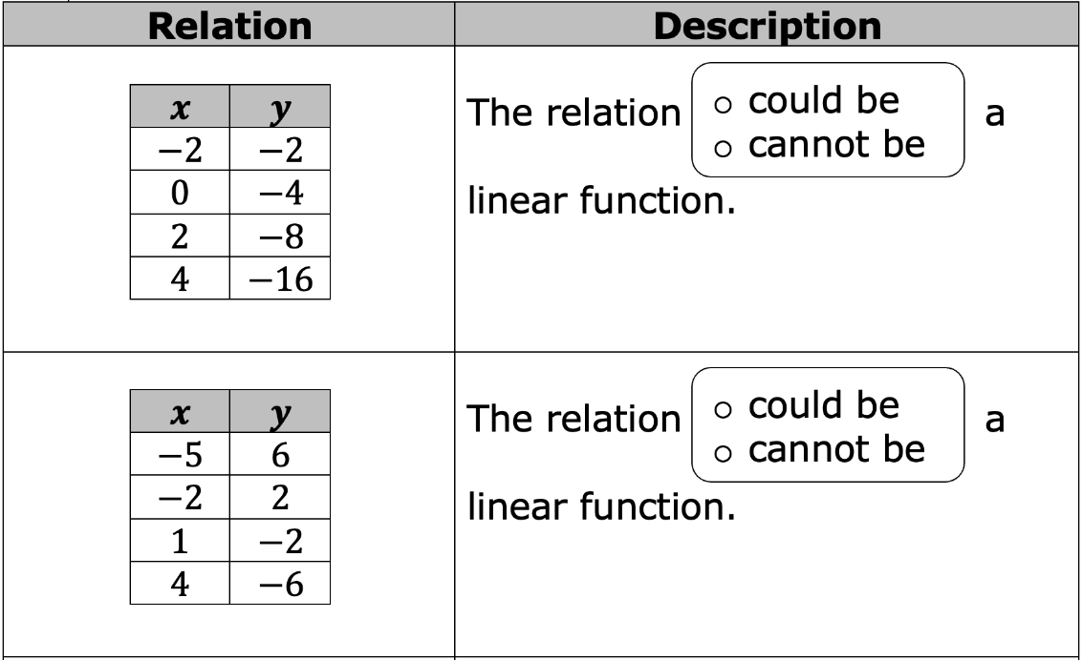
10.10.5 Wrap-Up: Ticket Out the Door
Complete the table to describe each relation.
volume 2, pg. 173

Slide 26
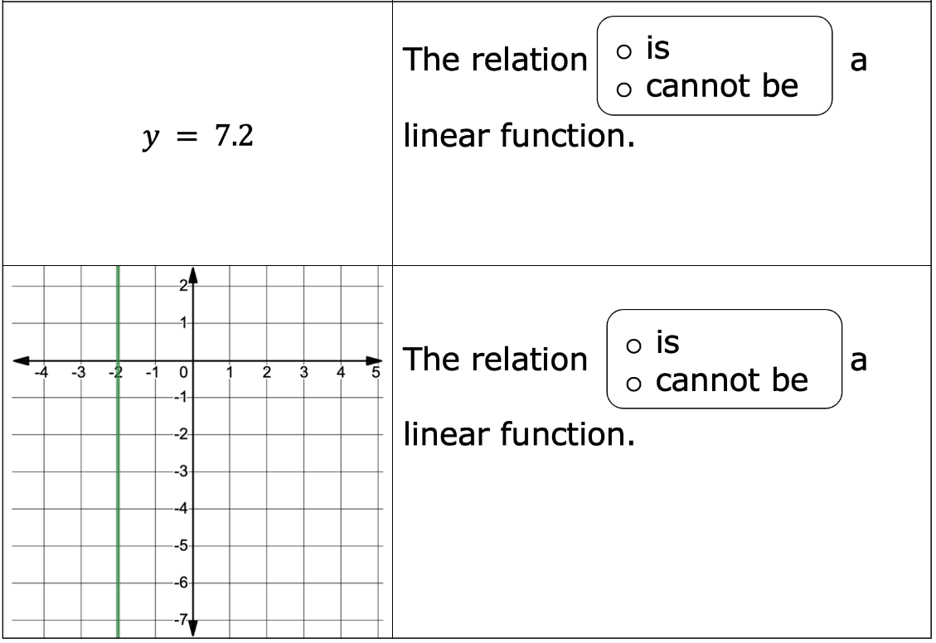
volume 2, pg. 173

